Slide 1

Bash on Windows 10 Windows Subsystem for Linux
Jessica Deen
Technical Evangelist - Microsoft
www.jessicadeen.com | @jldeen Jessica.Deen@Microsoft.com

Slide 2



PowerShell Core and Bash on Windows 10
PowerShell
Linux and OS X
Heterogeneous world
Use any client
Run workloads on any server
And any cloud
Linux
OS X
Notes:
Open source
GitHub
MIT License
Open to community development
Contributors
Committers
Refactored on .NET Core
One code base for all OSes

Slide 3
MEET THE TEAM
Daniel Egan
Technical Evangelist
Livi Erickson Technical Evangelist
Andrew Moll
Technical Evangelist
Doris Chen Technical Evangelist
John Alioto
Principal Technical Evangelist
Tim Reilly Technical Evangelist
Tobiah Zarlez Technical Evangelist
Jeremy Foster Technical Evangelist
Tierney Wixted Community Evangelist
Beth Massi Program Manager
Annie Bubinski Community Evangelist
Jennelle Crothers Technical Evangelist
Robin Shahan Content Developer
Shaina Houston
Director of Community Evangelism
Joe Shirey
Director of Technical Evangelism
Jessica Deen Technical Evangelist
Justin Chizer
Microsoft Student Partner
Yesenia Alvarez
Community Evangelist

Slide 4
MEET OUR MVP/RDs
Jeremy Clark
Visual Studio and Dev Tech
David McCarter
Visual Studio and Dev Tech
Vishal Saxena
Microsoft Azure
Paul Hacker
Visual Studio and Dev Tech
Mathias Brandewinder
Visual Studio and Dev Tech
Deborah Kurata
Visual Studio and Dev Tech
Ward Bell Windows Development
Craig Berntson
Visual Studio and Dev Tech
Chander Dhall
Visual Studio and Dev Tech
Steve Evans
Visual Studio and Dev Tech

Slide 5

We’re Reimagining Microsoft
Our Mission
We will empower
every person and
every organization
on the planet
to achieve more
Notes:
[Script]:
Every great company has an enduring mission. We’ve challenged ourselves to think about our core mission, our soul – what would be lost if we disappeared.
We will empower every person and every organization on the planet to achieve more. We have unique capabilities in harmonizing the needs of both individuals and organizations. This is in our DNA. Perhaps “on the planet” is the most important and interesting idea in that statement. We care deeply about making a difference in lives and organizations in all corners of the planet.
Our strategy is to build best-in-class platforms and productivity services for a mobile-first, cloud-first world. Our platforms will harmonize the interests of end users, developers and IT better than any competing ecosystem or platform. We will realize our mission and strategy by investing in three interconnected and bold ambitions.
Again, doing so isn’t simply good business. It’s playing a part in the most fundamental of human activities: creating tools that enable each of us to continue our journey to become something more. In summary, we want to Empower you to achieve more!

Slide 6
We’re Reimagining Microsoft
Our Strategy
Build the best-in-class platforms and productivity services for the mobile-first, cloud-first world
Notes:
[Script]:
Every great company has an enduring mission. We’ve challenged ourselves to think about our core mission, our soul – what would be lost if we disappeared.
We will empower every person and every organization on the planet to achieve more. We have unique capabilities in harmonizing the needs of both individuals and organizations. This is in our DNA. Perhaps “on the planet” is the most important and interesting idea in that statement. We care deeply about making a difference in lives and organizations in all corners of the planet.
Our strategy is to build best-in-class platforms and productivity services for a mobile-first, cloud-first world. Our platforms will harmonize the interests of end users, developers and IT better than any competing ecosystem or platform. We will realize our mission and strategy by investing in three interconnected and bold ambitions.
Again, doing so isn’t simply good business. It’s playing a part in the most fundamental of human activities: creating tools that enable each of us to continue our journey to become something more. In summary, we want to Empower you to achieve more!

Slide 7



We’re Reimagining Microsoft
Our Ambitions
Reinvent productivity & business processes
Build the intelligent cloud platform
Create more personal computing
Notes:
[Script]:
Every great company has an enduring mission. We’ve challenged ourselves to think about our core mission, our soul – what would be lost if we disappeared.
We will empower every person and every organization on the planet to achieve more. We have unique capabilities in harmonizing the needs of both individuals and organizations. This is in our DNA. Perhaps “on the planet” is the most important and interesting idea in that statement. We care deeply about making a difference in lives and organizations in all corners of the planet.
Our strategy is to build best-in-class platforms and productivity services for a mobile-first, cloud-first world. Our platforms will harmonize the interests of end users, developers and IT better than any competing ecosystem or platform. We will realize our mission and strategy by investing in three interconnected and bold ambitions.
Again, doing so isn’t simply good business. It’s playing a part in the most fundamental of human activities: creating tools that enable each of us to continue our journey to become something more. In summary, we want to Empower you to achieve more!

Slide 8
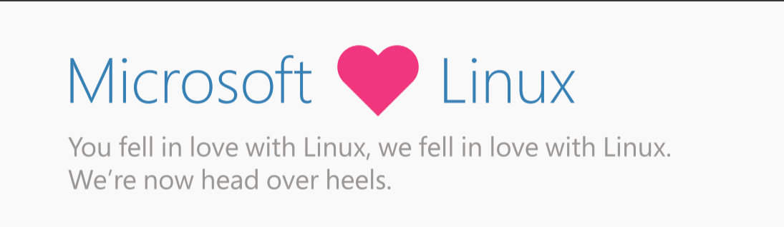
Notes:
Why is this transformation important? Let’s take a look at the next few years before us…
In 2020, 1 million new devices are expected to come online every hour. The connectivity between people and data is creating billions of new relationships that are driven not only by data but by algorithms that keep customers engaged and buying.*
In 2020, the average age of a S&P 500 corporation is expected to be 12 years old. Compare that to the S&P 500 in 1960 when the average age was 60 years old.**
By the year 2025, at least 60 percent of computing will be cloud-based, due to “everything-as-a-service” shifting fundamental changes in the IT industry.***
For digital transformation, mobility is the universal catalyst and cloud is the great enabler.
How are you planning for digital transformation? Do you have the right people and the right technology in place to build your digital vision?
How can you use technology to shape your future?
*http://www.gartner.com/newsroom/id/3142917
**http://upstart.bizjournals.com/resources/author/2015/06/04/fortune-500-must-disrupt-or-die-writes-r-ray-wang.html?page=all
***http://www.emersonnetworkpower.com/en-US/Latest-Thinking/Data-Center-2025/Documents/002401_DataCenter2025Report_HR_INTERACTIVE.PDF

Slide 9
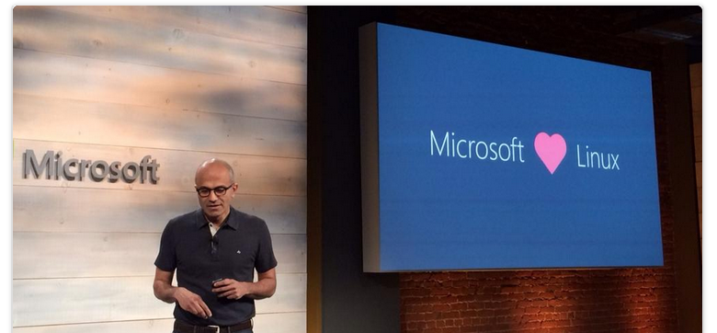
“This is not your Dad’s Microsoft.”

Slide 10
Microsoft and Open Source
Notes:
Open source
GitHub
MIT License
Open to community development
Contributors
Committers
Refactored on .NET Core
One code base for all OSes

Slide 11
Enable
Notes:
Enable Linux and Open Source technology to be first class citizens on Microsoft Platforms

Slide 12
Integrate
Notes:
Integrate - Embrace leading Open Source ecosystems and integrate Microsoft products with agility and consistency

Slide 13
Release
Notes:
Release - Release key Microsoft technologies into the Open Source domain to build a strong ecosystem

Slide 14
Participate
Notes:
Participate - Microsoft engineers to participate in communities and contribute to key Open Source Projects

Slide 15
Assumptions
Basic knowledge of Linux
Windows 10 Anniversary Update Installed
Systems Administration / Network Administration Experience
Notes:
[Script]:
Every great company has an enduring mission. We’ve challenged ourselves to think about our core mission, our soul – what would be lost if we disappeared.
We will empower every person and every organization on the planet to achieve more. We have unique capabilities in harmonizing the needs of both individuals and organizations. This is in our DNA. Perhaps “on the planet” is the most important and interesting idea in that statement. We care deeply about making a difference in lives and organizations in all corners of the planet.
Our strategy is to build best-in-class platforms and productivity services for a mobile-first, cloud-first world. Our platforms will harmonize the interests of end users, developers and IT better than any competing ecosystem or platform. We will realize our mission and strategy by investing in three interconnected and bold ambitions.
Again, doing so isn’t simply good business. It’s playing a part in the most fundamental of human activities: creating tools that enable each of us to continue our journey to become something more. In summary, we want to Empower you to achieve more!

Slide 16
- How to setup and enable bash on Ubuntu on Windows 10 - Run some basic Linux commands - Configure SSH - Install an x11 Server on Windows - Visual Studio Code w/ bash on Windows
What we will cover
Notes:
Install scripts provided
Open source
GitHub
MIT License
Open to community development
Contributors
Committers
Refactored on .NET Core
One code base for all OSes

Slide 17
DEMO
Notes:
We’ve gone through a journey today, through the various capabilities of Azure that support your path toward digital transformation, from app innovation, to data and intelligence, to open and flexible deployments, to trust. We’re here to partner with you as you continue to innovate and transform. Thank you.

Slide 18
Q & A
Notes:
We’ve gone through a journey today, through the various capabilities of Azure that support your path toward digital transformation, from app innovation, to data and intelligence, to open and flexible deployments, to trust. We’re here to partner with you as you continue to innovate and transform. Thank you.

Slide 19
MAKE THE MOST OF YOUR EXPERIENCE
Complete the survey for a chance to win Beats by Dre Headphones
Survey → aka.ms/SVCC
Visit our booth
Connect with our speakers
Submit Your Session Cards
Fill out a session card to enter a raffle for a Ricoh Theta 360 camera
Microsoft Azure Essentials book giveaway for survey completion while supplies last

Slide 20
What Next?
GitHub https://github.com/jldeen/SVCC-BashW10
Deck
Outline for Demo
Settings.json file for VS Code
Learn more about Azure, Cloud, OSS, Linux, PS, etc. http://jessicadeen.com/

Slide 21
Thank you
Notes:
We’ve gone through a journey today, through the various capabilities of Azure that support your path toward digital transformation, from app innovation, to data and intelligence, to open and flexible deployments, to trust. We’re here to partner with you as you continue to innovate and transform. Thank you.

